Slide 1


Network protocols & security
24EC2210
Topic:
Switching
Session - 6

Slide 2



AIM OF THE SESSION
To familiarize students with different switching techniques in Computer networks.
INSTRUCTIONAL OBJECTIVES
This Session is designed to:
Describe the need for switching in computer networks.
Describe different switching techniques.
LEARNING OUTCOMES
At the end of this session, you should be able to:
Understand the importance of Switching.
Categorize different switching techniques.

Slide 3
SWITCHING
Switching is the technique of transferring the information from one computer network to another network.
Switching in a computer network is achieved by using switches.
Network switches operate at layer 2 (Data link layer) in the OSI model.
Network switches operate at Layer 2 of the OSI model, facilitating more efficient and selective data transmission.
Switches are used to forward the packets based on MAC addresses.

Slide 4
SWITCHING: Circuit Switching
Circuit Switching:
When two nodes communicate with each other over a dedicated communication path, it is called circuit switching.
In circuit switching, to transfer the data, circuit must be established so that the data transfer can take place.
Circuits can be permanent or temporary.
Applications which use circuit switching may have to go through three phases:
Establish a circuit
Transfer the data
Disconnect the circuit

Slide 5
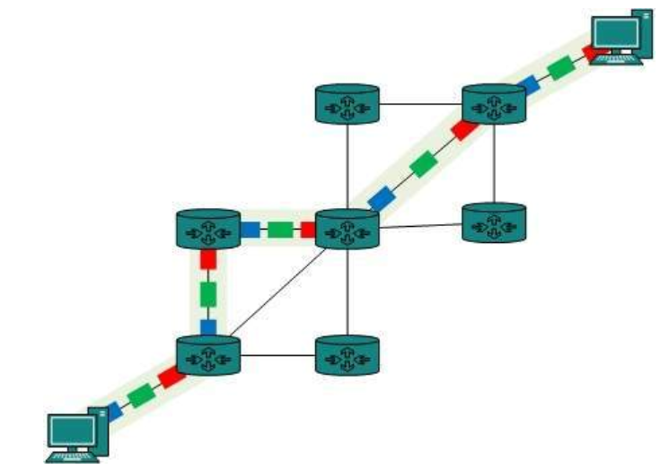
SWITCHING: Circuit Switching
Circuit Switching:
Circuit switching was designed for voice applications.
Telephone is the best suitable example of circuit switching.
Before a user can make a call, a virtual path between caller and callee is established over the network.

Slide 6
SWITCHING: Message Switching
Message Switching:
Message switching is in middle of circuit switching and packet switching.
In message switching, the whole message is treated as a data unit and is transferred entirely.
A switch working on message switching, first receives the whole message and buffers it until there are resources available to transfer it to the next hop (next switch).
If the next hop is not having enough resource to accommodate large size message, the message is stored and switch waits.

Slide 7
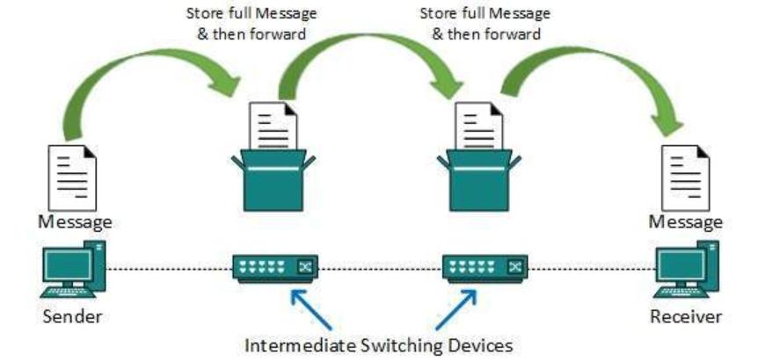
SWITCHING: Message Switching
Drawbacks of Message Switching:
Every switch in transit path needs enough storage to accommodate entire message.
Because of store-and-forward technique, message switching is very slow.
Message switching is not suitable for streaming media and real-time applications.

Slide 8
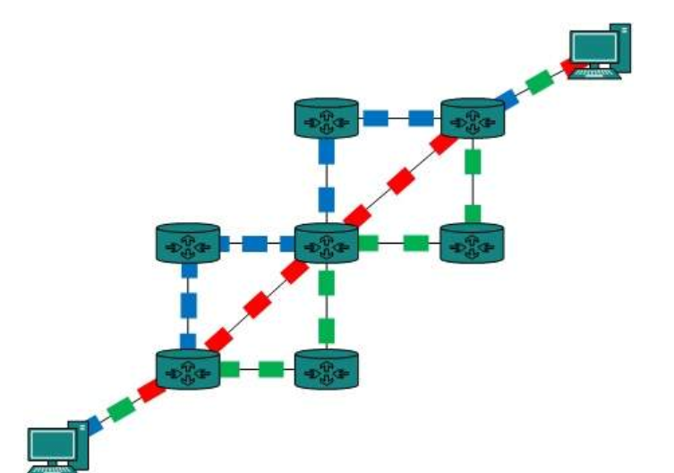
SWITCHING: Packet Switching
Packet Switching:
Shortcomings of message switching gave birth to an idea of packet switching.
The entire message is broken down into smaller chunks called packets.
The switching information is added in the header of each packet and transmitted independently.
The internet uses packet switching technique.
Advantage of Packet Switching:
It is easier for intermediate networking devices to store small size packets.
They do not take much resources either on carrier path or in the internal memory of switches.

Slide 9
SELF-ASSESSMENT QUESTIONS
In which of the following switching methods, the message is divided into small packets?
Circuit Switching
Message Switching
Packet Switching
Virtual Switching
Which of the following switch methods creates a point-to-point physical connection between two or more computers?
Circuit Switching
Message Switching
Packet Switching
Virtual Switching
3. A local telephone network is an example of a _______ network.
Circuit Switching
Message Switching
Packet Switching
Virtual Switching

Slide 10
SELF-ASSESSMENT QUESTIONS
In which of the following switching methods, the message is divided into small packets?
Circuit Switching
Message Switching
Packet Switching
Virtual Switching
Which of the following switch methods creates a point-to-point physical connection between two or more computers?
Circuit Switching
Message Switching
Packet Switching
Virtual Switching
3. A local telephone network is an example of a _______ network.
Circuit Switching
Message Switching
Packet Switching
Virtual Switching

Slide 11

Topic Summary
Switching Techniques
Circuit Switching
Message Switching
Packet Switching

Slide 12
REFERENCES FOR FURTHER LEARNING OF THE SESSION
Reference Books:
A.S. Tanenbaum, David J. Wetheral “Computer Networks” Pearson, 5th Edition.
Kurose, J and Ross, K Computer Networking: A Top-Down Approach Addison-Wesley- 6th edition.
Sites and Web links:
https://www.geeksforgeeks.org/types-of-transmission-technology/
https://www.tutorialspoint.com/data_communication_computer_network/computer_network_topologies.htm
3. https://www.javatpoint.com/computer-network-transmission-modes

Slide 13
THANK YOU
Team – Network Protocols & Security

